Slide 1
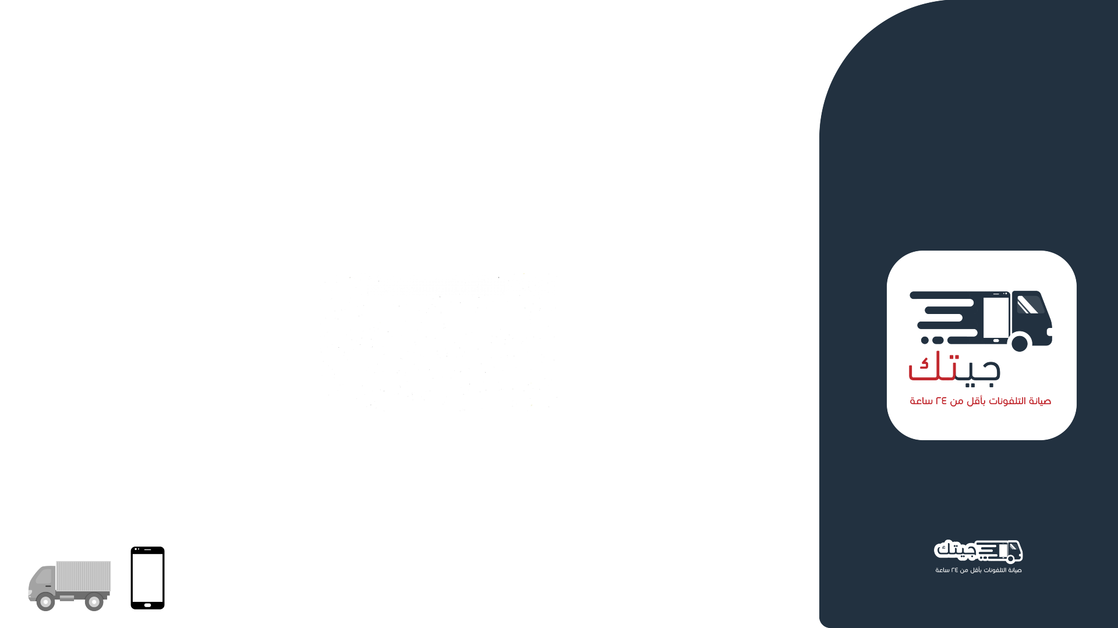
Orange Coding Academy,
Full Stack Web Development
Final Project Presentation
G-Tak
Done By :
Sadi Ashlaq.

Slide 2

Project Objective
This work takes the responsibility of building a web Application public site and admin dashboard.

Slide 3
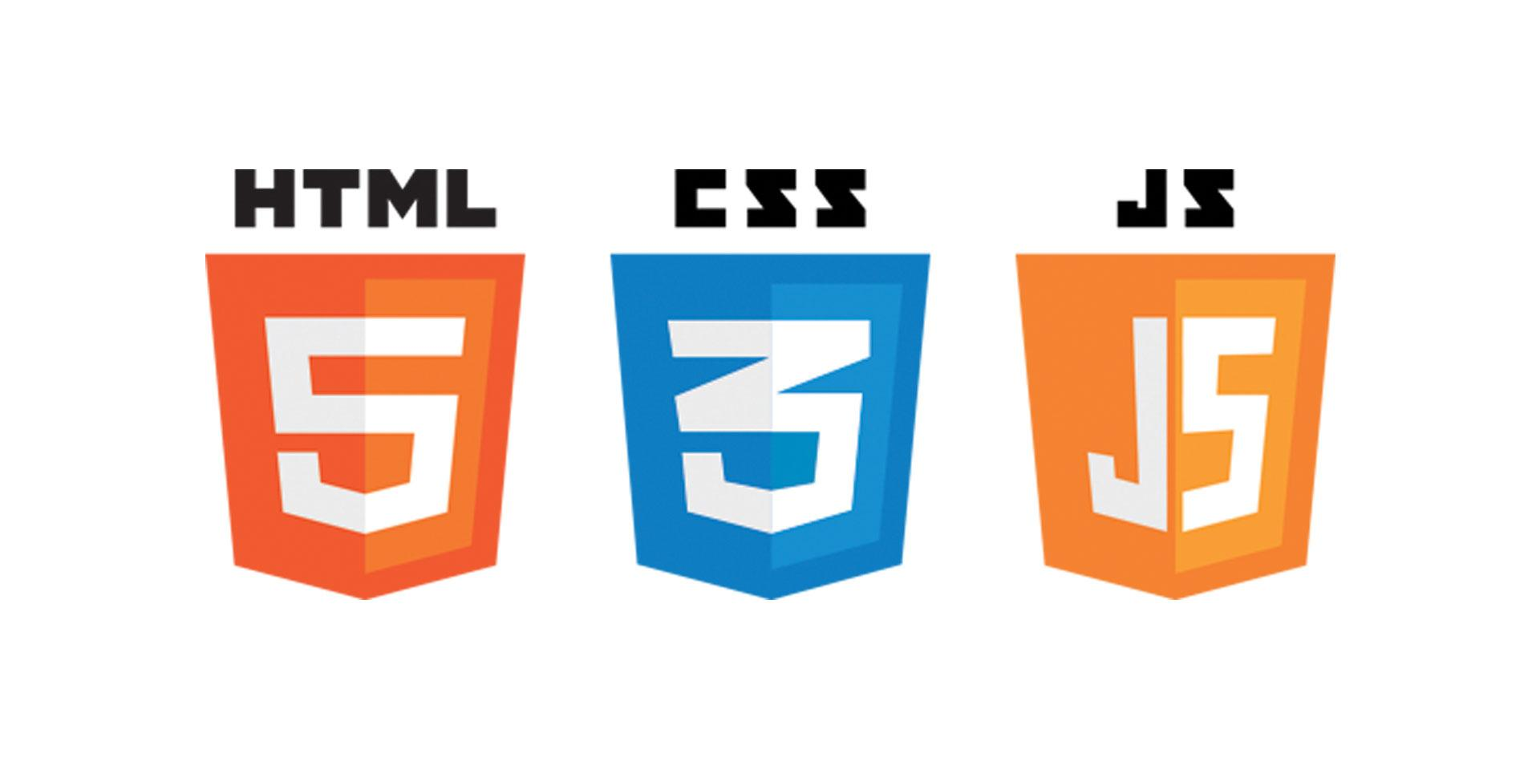



PROJECT’S Technology

Slide 4
Live Demo

Slide 5
Thank You

